Slide 1
Datasets for Term-1
File created on: 5/3/2024 10:20:32 AM

Slide 2
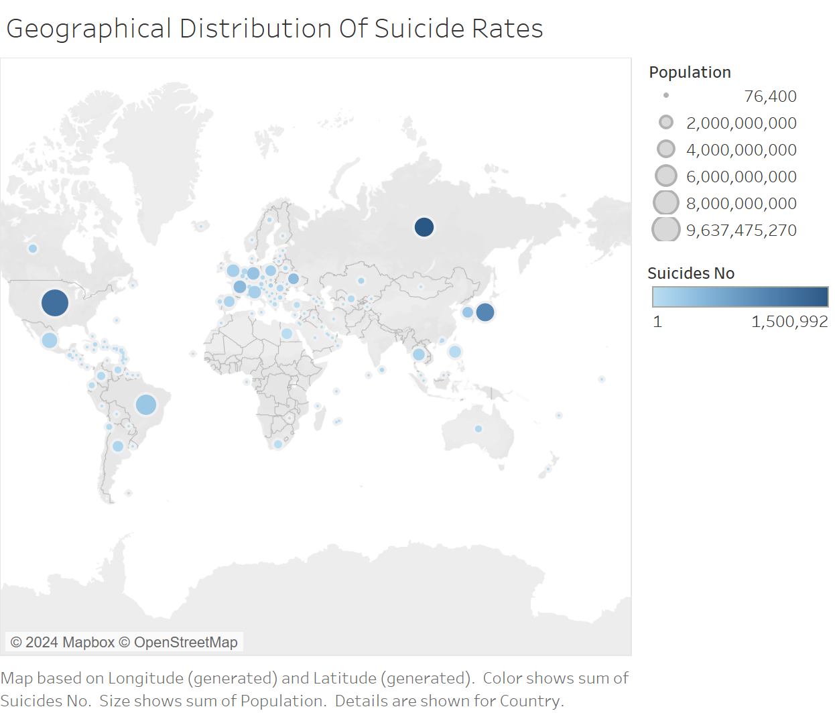

Slide 3
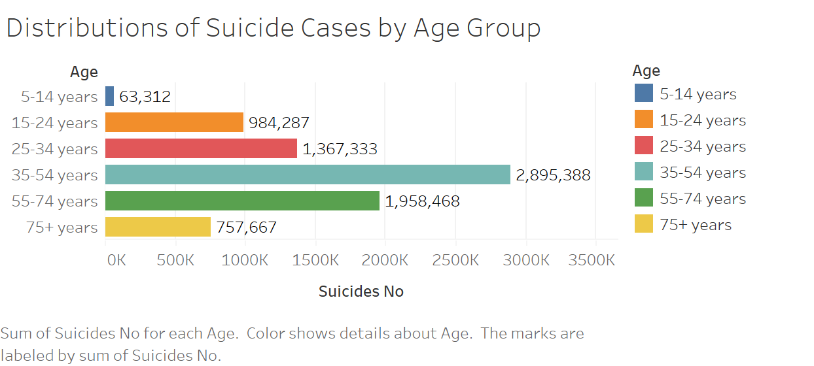

Slide 4
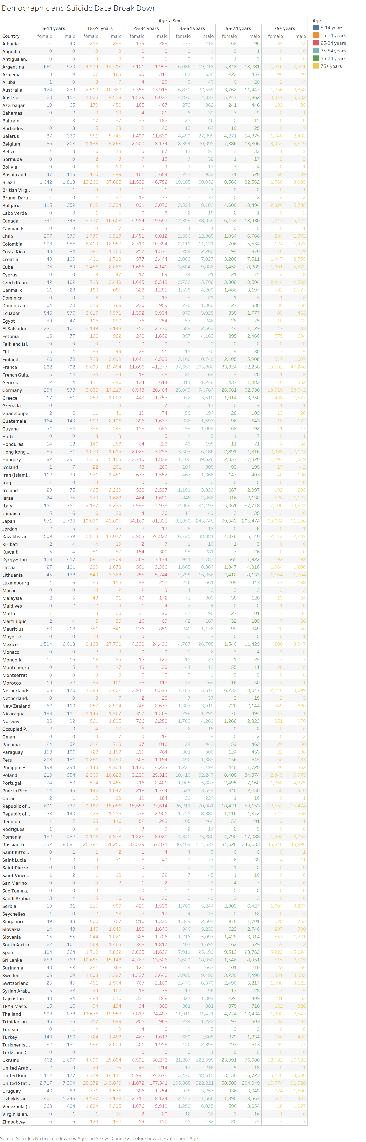

Slide 5
